Slide 1
Module-2: ARRAYS AND STRINGS :
Introduction to Arrays: Declaration, Initialization, One dimensional array, Two dimensional arrays.
String operations: length, compare, concatenate, copy
Searching and Sorting: Selection sort, linear and binary search.

Slide 2
Introduction to Arrays:
In C, an array is a collection of elements of the same data type stored in contiguous memory locations. Arrays allow you to store multiple values in a single variable name, making it easier to work with related data.
Key Characteristics of Arrays:
Fixed Size: The size of an array is defined at the time of its declaration and cannot be changed during runtime.
Homogeneous Elements: All elements in an array must be of the same data type (e.g., all integers, all floats, etc.).
Contiguous Memory: Array elements are stored in adjacent memory locations.
Indexing: Array elements are accessed using indices, starting from 0.

Slide 3


Syntax of Array Declaration:
data_type: The type of elements stored in the array (e.g., int, float, char).
array_name: The name of the array.
size: The number of elements the array can hold.
Example-1:
Example-2: initialize an array while declaring it

Slide 4

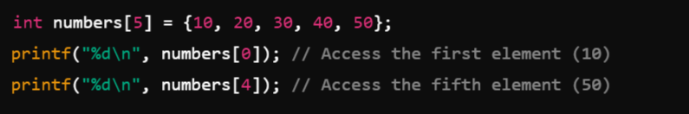
Accessing Array Elements:
Array elements are accessed using their index in square brackets ([]).
Syntax:
Example:

Slide 5
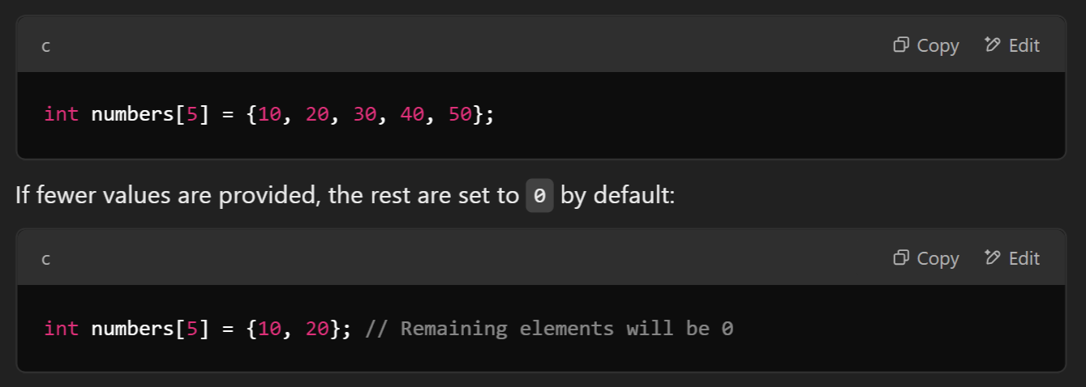

Initializing an Array: An array can be initialized during or after declaration.
During Declaration:

Slide 6
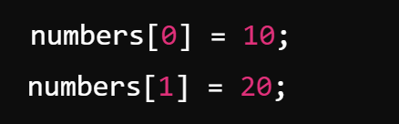
2. After Declaration:

Slide 7
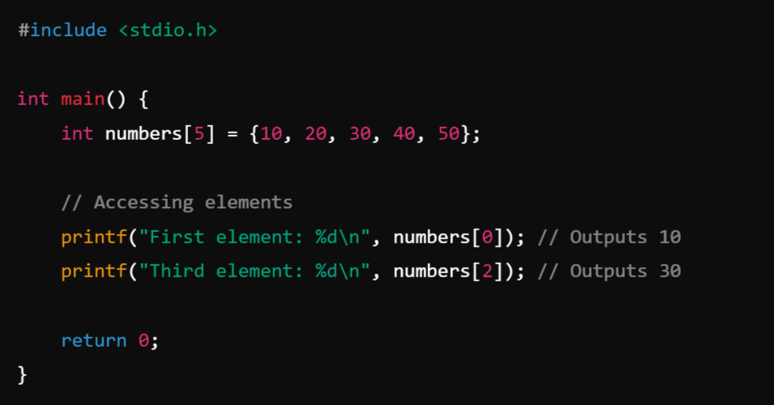
Example:

Slide 8
Types of Arrays in C:
In C programming, arrays are classified based on the number of dimensions they have. These dimensions determine how the data is organized and accessed.
The 3 main types of arrays in C are:
One-Dimensional Array (Requires one index to access elements)
Two-Dimensional Array (Requires two indices to access elements)
Three or Multi-Dimensional Array ((Array of more than one Two-Dimensional Array)
Note: In the context of arrays in C, dimensions refer to the levels of indexing or the number of indices required to uniquely access each element in the array. Each dimension adds a layer of organization to the data, allowing arrays to represent more complex structures like tables (2D) or cubes (3D).

Slide 9


One-Dimensional Array:
A one-dimensional array is a linear collection of elements, all of the same data type. It can be visualized as a list.
Requires one index to access elements.
Syntax:
Example:

Slide 10
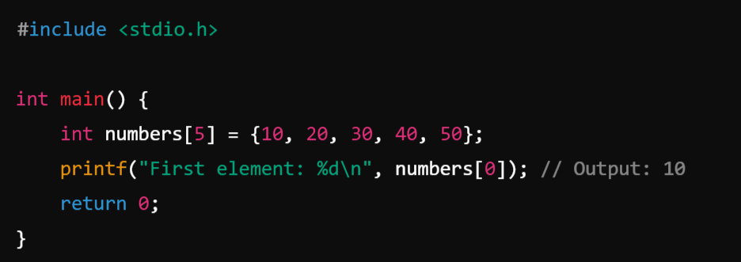
Example:

Slide 11

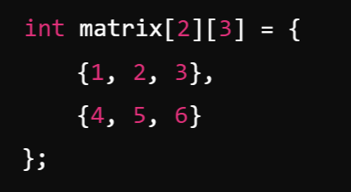
2. Two-Dimensional Array: ( Array of more than one One-Dimensional Array)
A two-dimensional array is a collection of elements arranged in rows and columns, like a table or matrix.
It is essentially an array of more than one One-Dimensional arrays.
Requires two indices to access elements
Syntax:
Example:
Accessed using two indices (array_name[row][column]).
The first index represents the row, and the second represents the column.

Slide 12
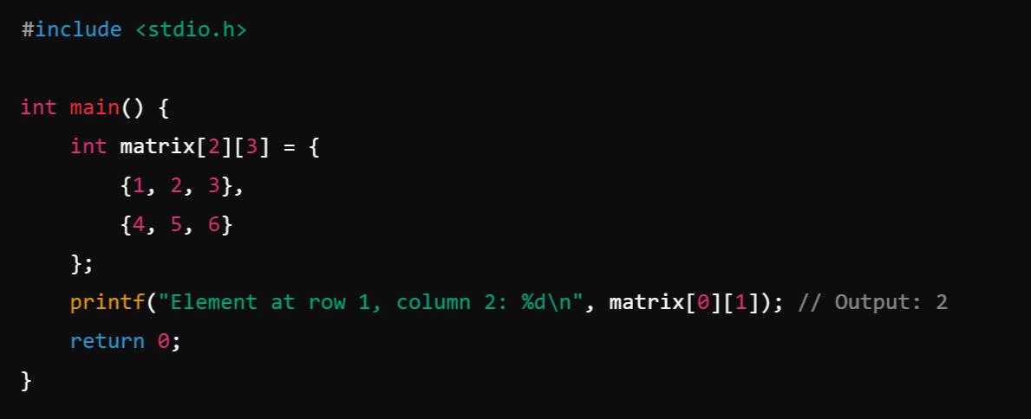
Example:

Slide 13

3. Multi-Dimensional Array: A multi-dimensional array extends the concept of a two-dimensional array to more than two dimensions (e.g., 3D, 4D).
Syntax:
Example:
Characteristics:
  Accessed using multiple indices (array_name[index1][index2][index3]...).
  Each additional dimension increases the complexity of indexing and storage.

Slide 14
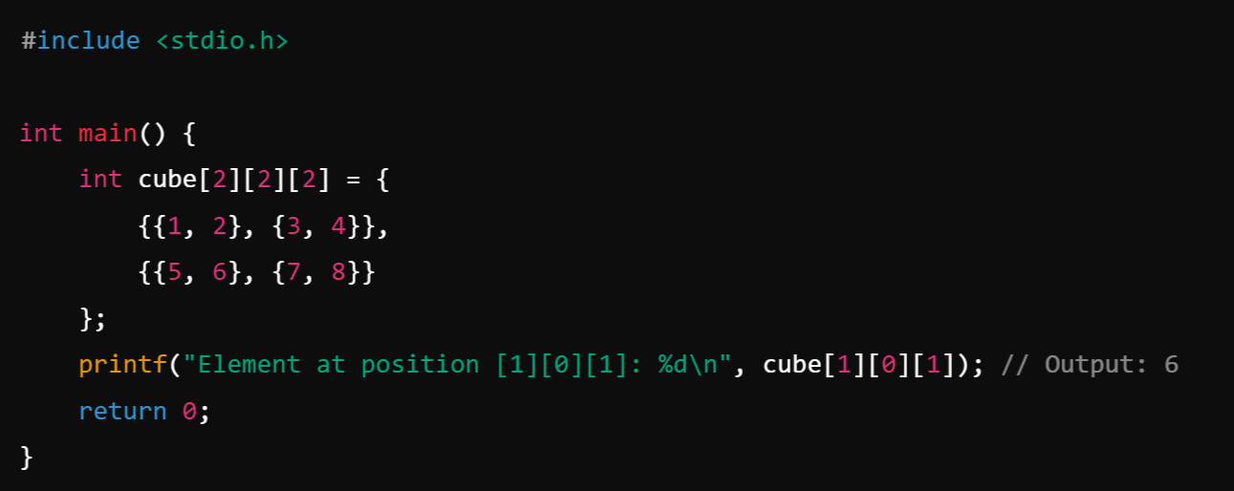
Example:

Slide 15
Limitations of Arrays:
Fixed size: Cannot resize during runtime.
Homogeneous data: Only one data type allowed.
Static memory allocation may lead to wastage if the array is not fully utilized.

Slide 16
Strings in C:
In C programming, a string is essentially an array of characters that is terminated by a special character called the null character (\0).
This null character marks the end of the string, distinguishing it from other arrays of characters.

Slide 17

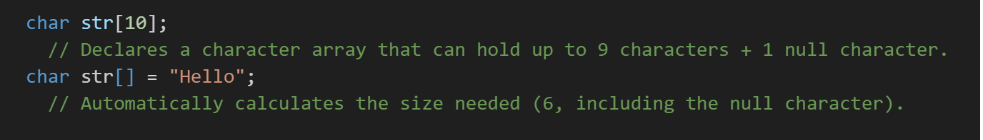
Characteristics of Strings in C:
Null Termination: Every string in C is terminated with the null character \0. This allows functions like printf to know where the string ends.
  Example: The string "Hello" is stored in memory as
Declaration: Strings can be declared as

Slide 18
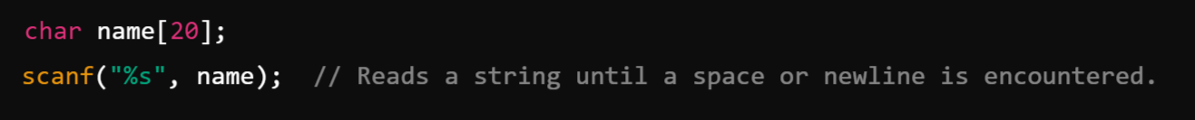

3. Input and Output:
To read a string:
To print a string

Slide 19
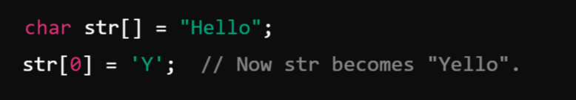
4. String Handling Functions: The string.h header file provides useful functions to work with strings:
strlen(str): Returns the length of the string (excluding \0).
strcpy(dest, src): Copies the string src into dest.
strcat(dest, src): Concatenates src at the end of dest.
strcmp(str1, str2): Compares two strings (0 if they are equal, non-zero otherwise).
5. String Manipulation: Strings in C are mutable (modifiable). You can modify individual characters

Slide 20
String operations:
In C, string operations include creating, manipulating, and analyzing strings. The string.h header file provides a variety of built-in functions for working with strings.

Slide 21
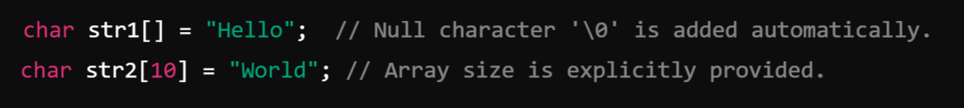
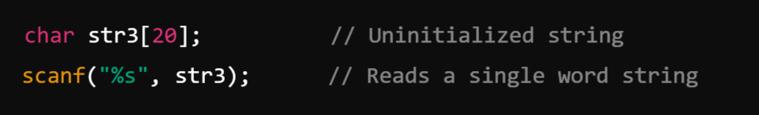
String Initialization: Strings are declared as arrays of characters and must be null-terminated.
Example:

Slide 22
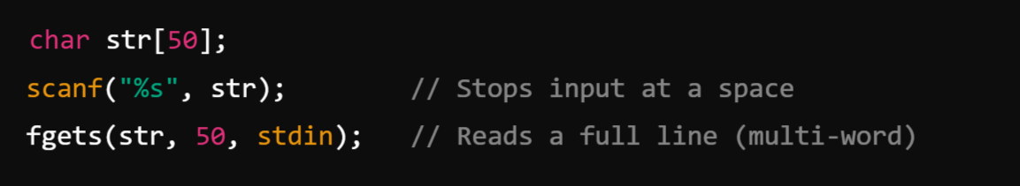
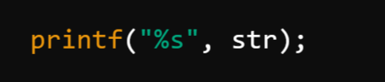
2. String Input and Output
Input:
  Use scanf for single-word strings.
  Use fgets for multi-word strings.
Output: Use printf to display strings.
str: A pointer to the character array where the input string will be stored.
n: The maximum number of characters to read (including the null terminator \0).
stream: The input stream to read from (e.g., stdin, a file pointer, etc.).

Slide 23

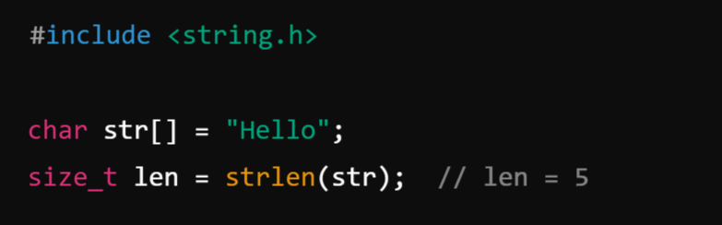
3. Finding String Length: Use strlen() to find the length of a string (excluding the null terminator).
Prototype:
Parameter: A pointer to the string (const char *str).
Return Type: The length of the string as a value of type size_t, which is an unsigned integral type.
Example:

Slide 24
4. Copying Strings: In C, copying strings involves transferring the content of one string (source) into another string (destination). Use strcpy or strncpy to copy one string into another.
strcpy does not perform bounds checking.
strncpy allows you to specify the number of characters to copy.
Using strcpy():
The strcpy function copies the entire source string (including the null terminator \0) into the destination string.
Prototype:
Destination: Must be large enough to hold the source string, including the null terminator.
Source: The string to be copied.
Return Value: A pointer to the destination string.

Slide 25
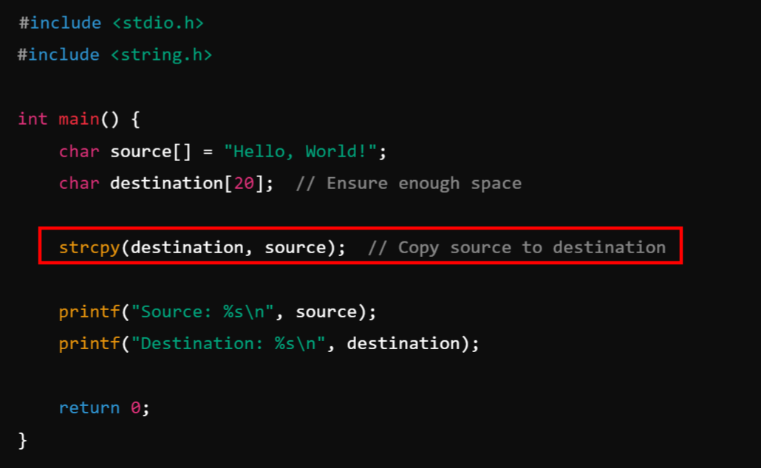
Example:

Slide 26
Using strncpy():
The strncpy function allows you to specify the number of characters to copy. This is safer and prevents buffer overflow if the source string is larger than the destination buffer.
Prototype:
num: Maximum number of characters to copy.
Null Termination: If the source string length is less than num, the destination string is padded with null characters (\0).
If the source is longer than num, the destination will not be null-terminated, so you may need to handle this manually.

Slide 27
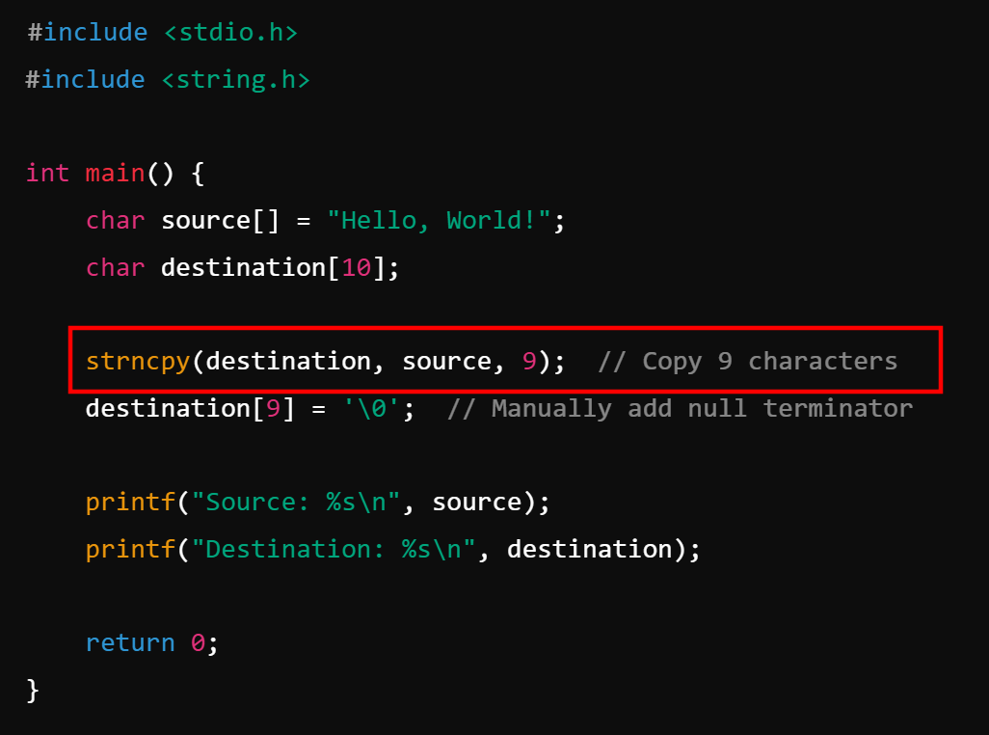
Example:

Slide 28
5. Concatenating Strings: String concatenation in C involves joining two strings into one by appending the characters of one string (source) to the end of another (destination). Use strcat or strncat to concatenate two strings.
strcat appends the second string to the first.
strncat allows you to specify the number of characters to append.
Using strcat():
The strcat function concatenates the source string to the destination string, starting at the null terminator (\0) of the destination.
Prototype:
Destination: Must be large enough to hold the resulting string, including the null terminator.
Source: The string to be appended.
Return Value: A pointer to the destination string.

Slide 29
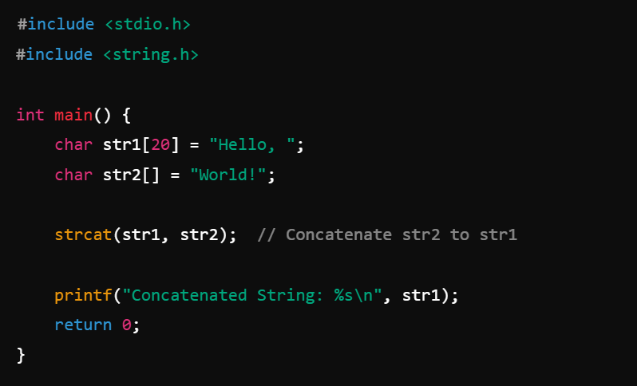
Example:

Slide 30
Using strncat():
The strncat function is a safer version of strcat. It allows you to specify the maximum number of characters to append.
Prototype:
num: Specifies the maximum number of characters to append from the source string.
Appends at most num characters and ensures the resulting string is null-terminated.
Useful when the size of the destination buffer is limited.

Slide 31
6. Comparing Strings:
In C, comparing strings is done to determine their equality, lexical order, or differences. Strings are compared character by character, and C provides built-in functions in the string.h library for these operations.
Use following functions to compare two strings:
strcmp() compares strings lexicographically (Alphabetically).
strncmp() compares only the first n characters.
strcasecmp() performs a case-insensitive comparison.

Slide 32

String Comparison Using strcmp():
The strcmp function compares two strings lexicographically (dictionary order).
Prototype:
Return Values:
  Returns 0 if the strings are equal.
  Returns a negative value if str1 is less than str2.
  Returns a positive value if str1 is greater than str2.
Comparison is case-sensitive.

Slide 33
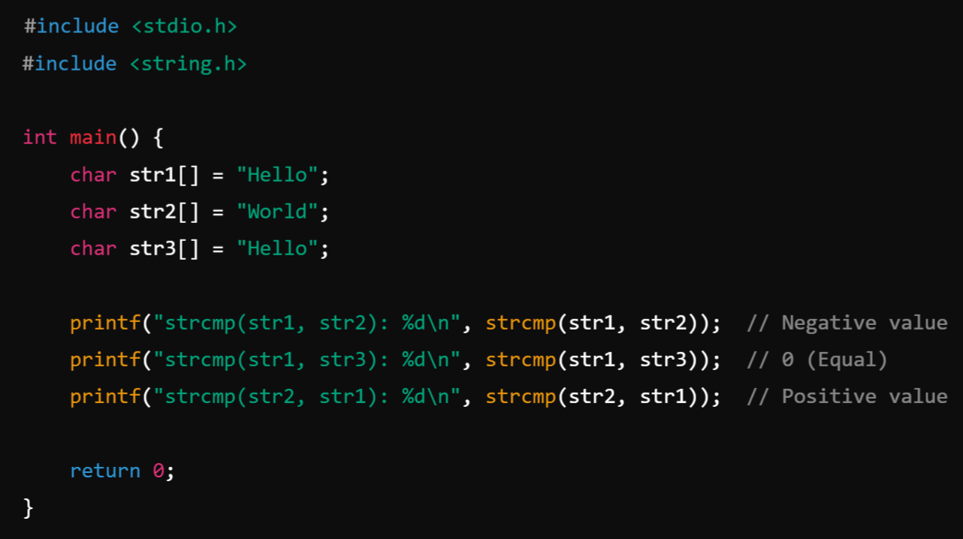
Example:

Slide 34
String Comparison Using strncmp():
The strncmp function compares up to the first n characters of two strings.
Prototype:
Limits the comparison to at most n characters.
Useful for partial string comparisons or ensuring bounds safety.
Like strcmp, it is case-sensitive.

Slide 35
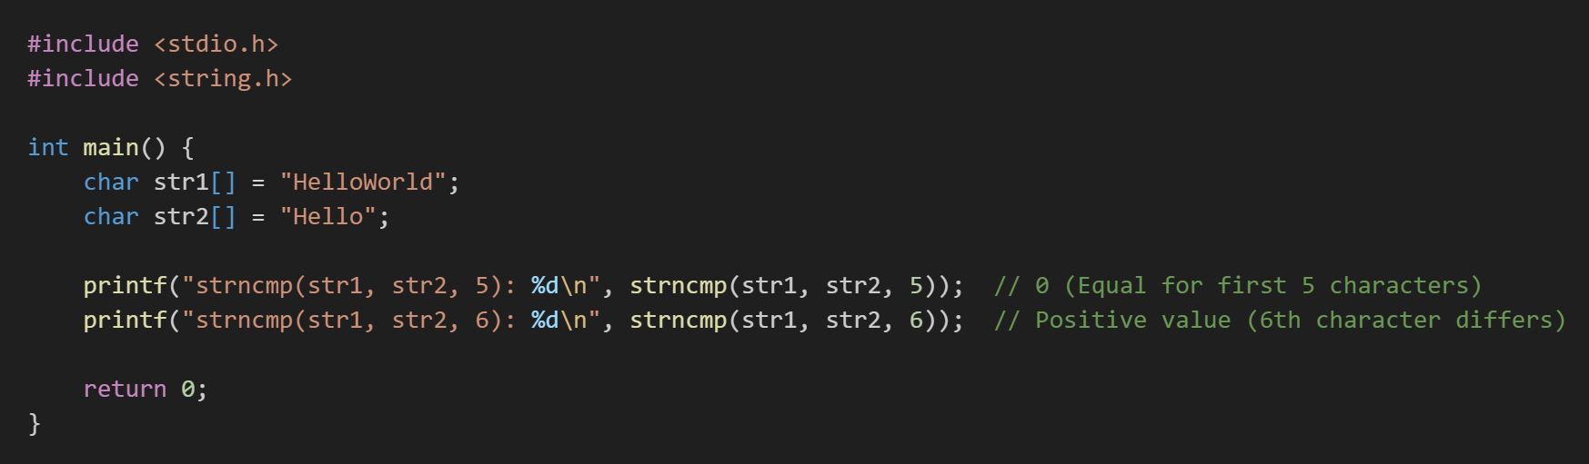
Example:

Slide 36
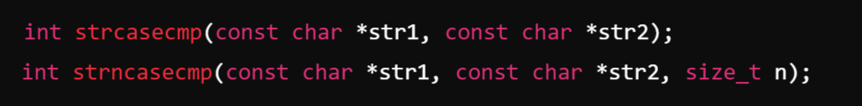
Case-Insensitive Comparison:
The standard C library does not include a built-in case-insensitive string comparison function, but some compilers provide strcasecmp and strncasecmp for this purpose.
Prototype (Non-Standard):

Slide 37
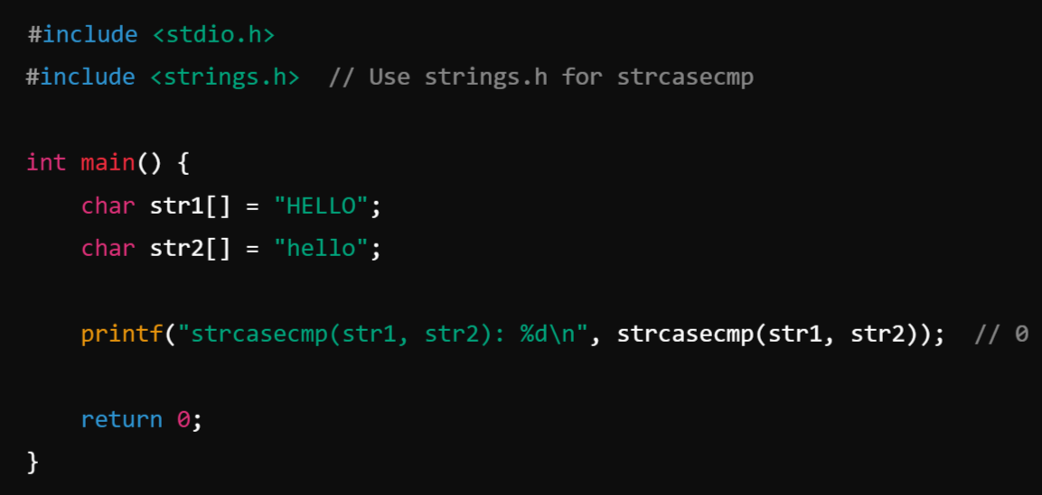
Example:

Slide 38
Searching and Sorting

Slide 39
Searching:
Searching is the process of finding the location of a specific element (key or target) in a collection of elements, such as an array, list, or database.
In programming, searching algorithms are used to locate data efficiently, and the choice of algorithm depends on the data structure and the nature of the data.
Types of Searching Techniques
Linear Search
Binary Search

Slide 40
Linear Search:
Linear Search, also known as Sequential search, is the simplest search algorithm. It works by checking each element in a collection one by one until the desired element (key) is found or the end of the collection is reached.
Characteristics of Linear Search:
Unsorted Data: Linear search works on both sorted and unsorted data.
Time Complexity:
  Best Case: O(1) (if the target is at the beginning).
  Worst Case: O(n) (if the target is at the end or not present).
  Average Case: O(n)
Space Complexity: O(1) (no extra space required).

Slide 41
How Linear Search Works:
Start from the first element of the collection.
Compare the current element with the target (key).
If they match, return the index of the current element.
If they don't match, move to the next element.
Repeat steps 2-4 until the target is found or the end of the collection is reached.
If the entire collection is traversed without a match, return an indication that the element is not found (e.g., -1).

Slide 42
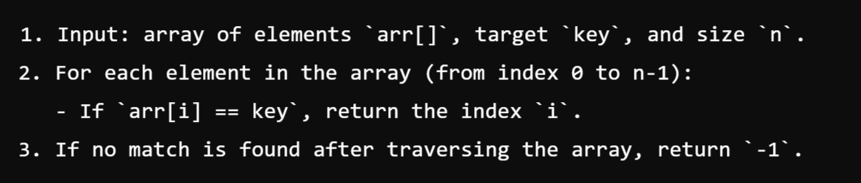
Algorithm:

Slide 43
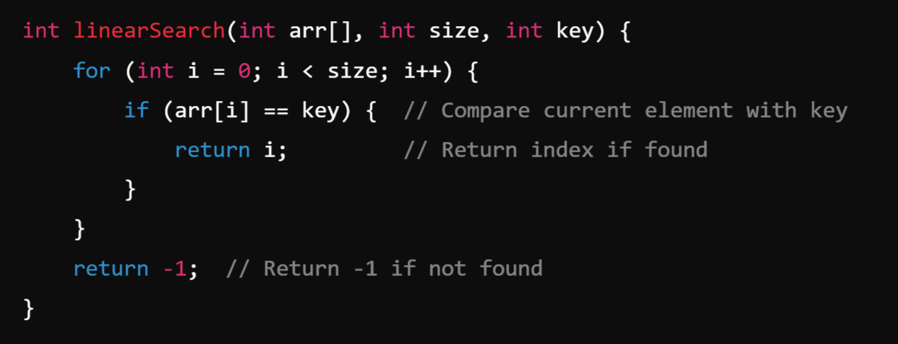
Implementation in C : Example 1: Integer Array

Slide 44
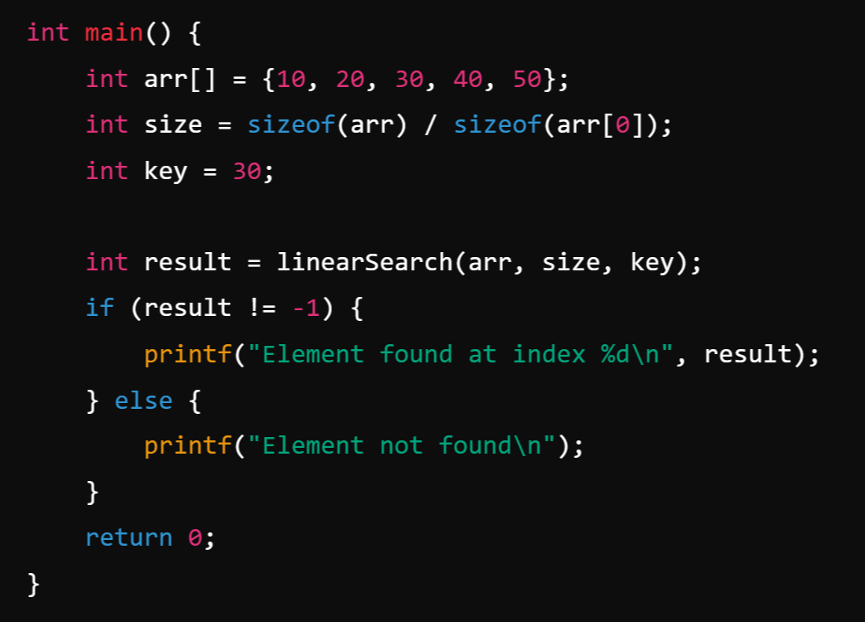
Main Method:

Slide 45
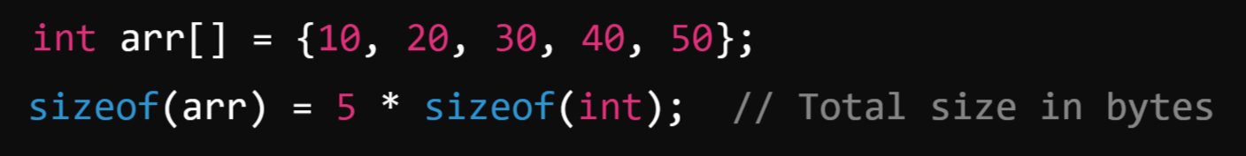
How int size = sizeof(arr) / sizeof(arr[0]) Works?
sizeof(arr): The sizeof operator returns the total memory size (in bytes) occupied by the entire array arr.
  For example:
  If sizeof(int) is 4 bytes, then sizeof(arr) will be 5×4 = 20 bytes.

Slide 46
2. sizeof(arr[0]):
arr[0] refers to the first element of the array.
The sizeof operator returns the memory size (in bytes) of this single element.
For example:
3. Division:
To calculate the number of elements in the array, divide the total size of the array (sizeof(arr)) by the size of a single element (sizeof(arr[0])):

Slide 47
Binary Search:
Binary Search is an efficient algorithm for finding the position of a target element (key) in a sorted array. It works by repeatedly dividing the search interval in half until the target is found or the interval becomes empty.
Characteristics of Binary Search:
Works only on sorted data.
Time Complexity:
  Best Case: O(1) (if the middle element is the target).
  Worst Case: O(log⁡n) (halving the search interval each step).
  Average Case: O(log⁡n).
Space Complexity:
  Iterative version: O(1)
  Recursive version: O(log⁡n) (due to recursion stack).

Slide 48
How Binary Search Works:
Start with the entire array as the search interval.
Find the middle element of the current interval.
Compare the middle element with the target:
If the middle element is equal to the target, return its index.
If the target is smaller, search in the left half of the interval.
If the target is larger, search in the right half of the interval.
Repeat steps 2 and 3 until the target is found or the interval becomes empty (i.e., the low index exceeds the high index).

Slide 49
Algorithm
Iterative Version
Initialize low to 0 and high to n−1 (array bounds).
While low is less than or equal to high:
  Compute the middle index: mid=low+(high−low)/2
  If arr[mid] == key, return mid.
  If arr[mid] > key, search in the left half (high=mid−1).
  If arr[mid] < key, search in the right half (low=mid+1).
If the interval becomes empty, return -1 (target not found).

Slide 50
Recursive Version
Base Case:
  If low>high, return -1.
  Compute the middle index: mid=low+(high−low)/2.
  If arr[mid]==key, return mid.
Recursive Steps:
  If arr[mid]>key, search in the left half.
  If arr[mid]<key, search in the right half.

Slide 51
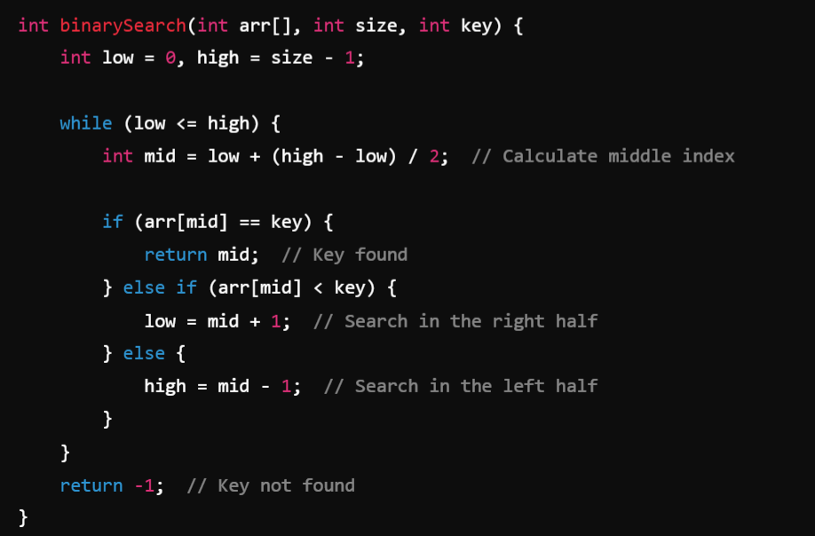
Implementation
Iterative Implementation:

Slide 52
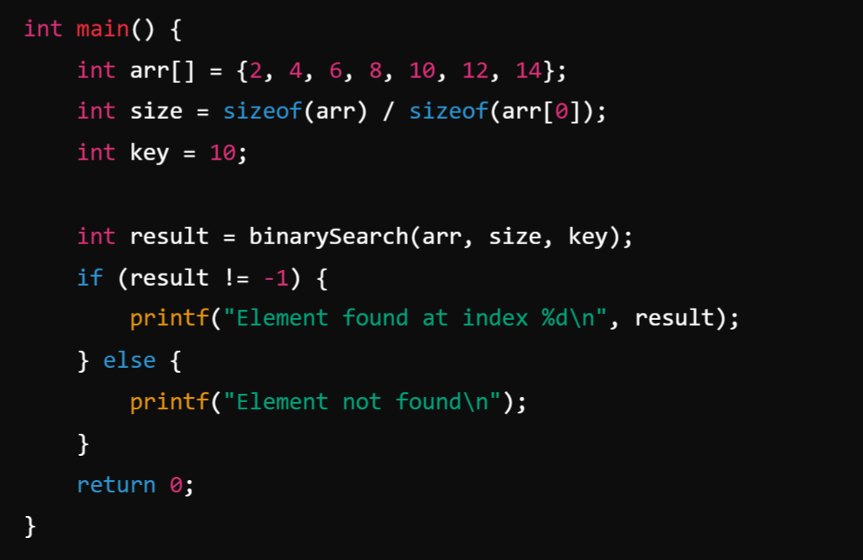
Main Method:

Slide 53
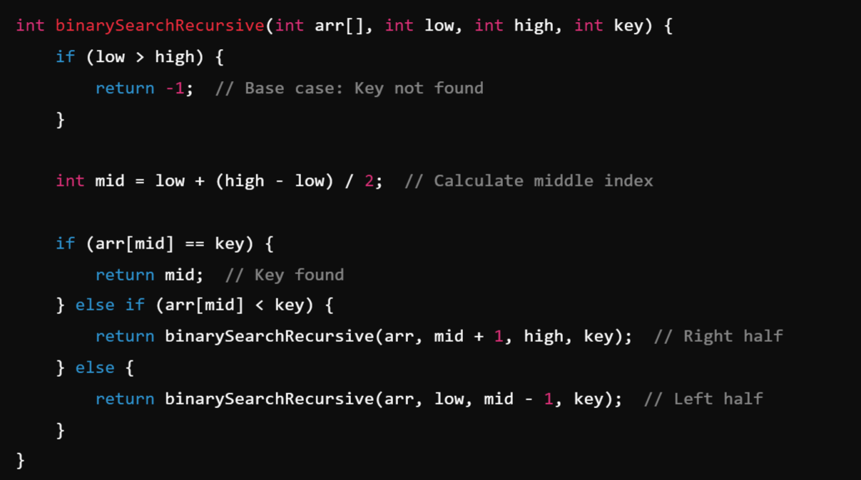
Recursive Implementation:

Slide 54
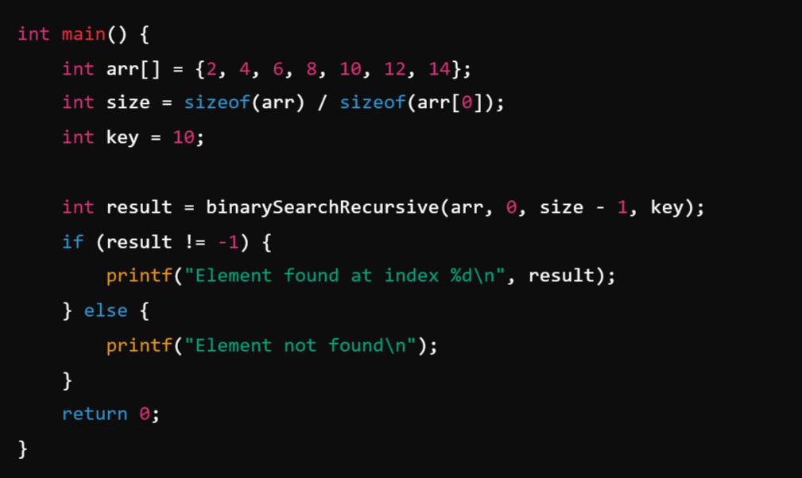
Main Method:

Slide 55
What is Sorting?
Sorting is the process of arranging data in a specific order, typically in ascending or descending order.
It is used to organize data to make it easier to search, analyze, and use.
Sorting is a fundamental operation in computer science and is widely used in algorithms and data structures.

Slide 56
Selection sort: (Dividing the List into 2 parts Sorted and Unsorted)
Selection Sort is a simple comparison-based sorting algorithm. It works by repeatedly selecting the smallest (or largest) element from the unsorted part of the array and swapping it with the first element of the unsorted part.
Algorithm Steps
STEP-1: START
STEP-2: Start from the first element of the array.
STEP-3: Find the smallest element in the unsorted part of the array.
STEP-4: Swap the smallest element with the first element of the unsorted part.
STEP-5: Move the boundary of the sorted part one step to the right.
STEP-6: Repeat the process for the remaining unsorted part of the array.
STEP-7: STOP

Slide 57
Example:
Let’s sort this array in ascending order:
64 | 25 | 12 | 22 | 11

Slide 58
Step-by-step working
Pass 1 (i = 0)
Unsorted part:
Find smallest element → 11
Swap 11 with first element 64
After swap:
First position is now sorted
64 | 25 | 12 | 22 | 11
11 | 25 | 12 | 22 | 64

Slide 59
Pass 2 (i = 1)
Unsorted part:
Smallest element → 12
Swap 12 with 25
After swap:
✔ First two elements sorted
25 | 12 | 22 | 64
11 | 12 | 25 | 22 | 64

Slide 60
Pass 3 (i = 2)
Unsorted part:
Smallest element → 22
Swap 22 with 25
After swap:
25 | 22 | 64
11 | 12 | 22 | 25 | 64

Slide 61
Pass 4 (i = 3)
Unsorted part:
Smallest element → 25
Already in correct place → no swap needed
Array becomes:
25 | 64
11 | 12 | 22 | 25 | 64

Slide 62
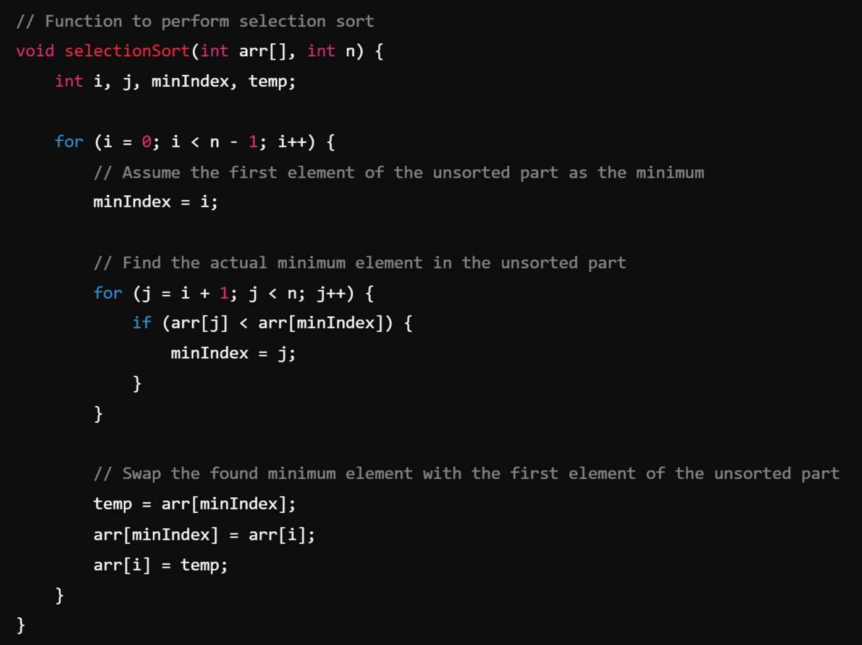
Program

Slide 63
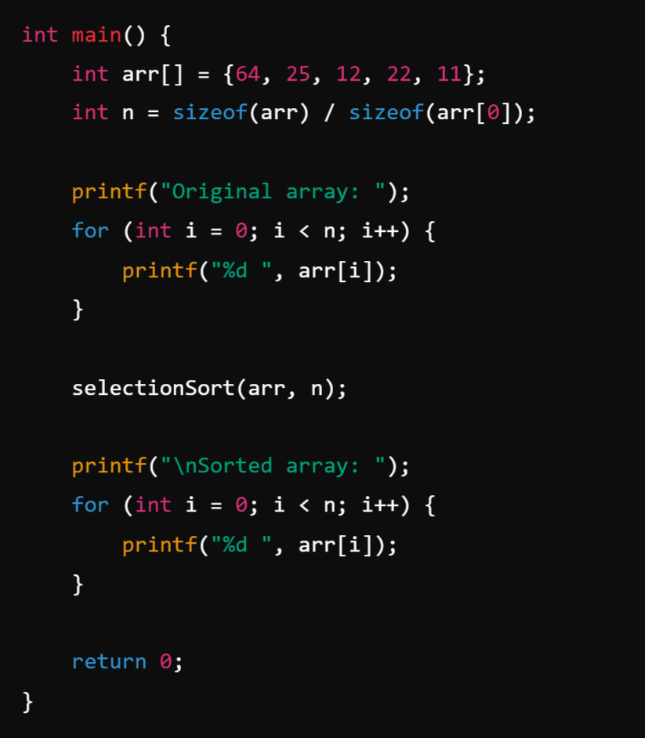
Main Method:

Slide 64
Bubble Sort?
Bubble Sort is a sorting algorithm where:
You repeatedly compare adjacent elements
Swap them if they are in the wrong order
Larger elements bubble up to the end
Why is it called Bubble Sort?
Because the largest elements move to the top (end) of the list like air bubbles in water.

Slide 65
Algorithm:
STEP-1: Compare the first two elements.
STEP-2: If the first is greater than the second, swap them.
STEP-3: Move to the next pair and repeat until you reach the end of the array.
STEP-4: After one full pass, the largest element is guaranteed to be at the last position.
STEP-5: Repeat the process for the remaining unsorted elements.

Slide 66
Example:
Let's sort the array: [5, 1, 4, 2]
Pass 1:
  ( 5, 1, 4, 2 ) → 5 > 1, so Swap → ( 1, 5, 4, 2 )
  ( 1, 5, 4, 2 ) → 5 > 4, so Swap → ( 1, 4, 5, 2 )
  ( 1, 4, 5, 2 ) → 5 > 2, so Swap → ( 1, 4, 2, 5 )
End of Pass 1: The largest number (5) is now at the end.

Slide 67
Pass 2:
  ( 1, 4, 2, 5 ) → 1 < 4, No Swap
  ( 1, 4, 2, 5 ) → 4 > 2, so Swap → ( 1, 2, 4, 5 )
End of Pass 2: The second largest number (4) is in its correct place.
Pass 3:
  ( 1, 2, 4, 5 ) → 1 < 2, No Swap
End of Pass 3: The array is fully sorted.
Final Sorted Array: [1, 2, 4, 5]

Slide 68
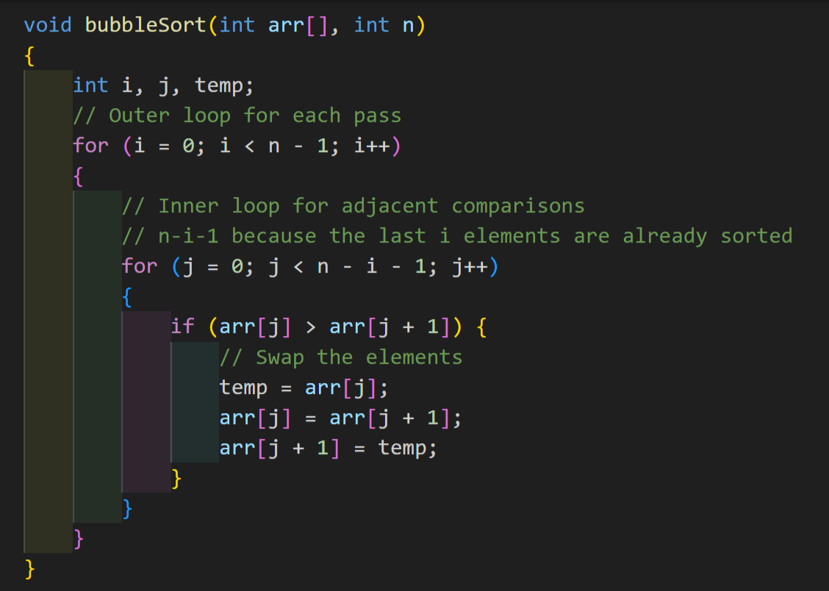
Code:

Slide 69
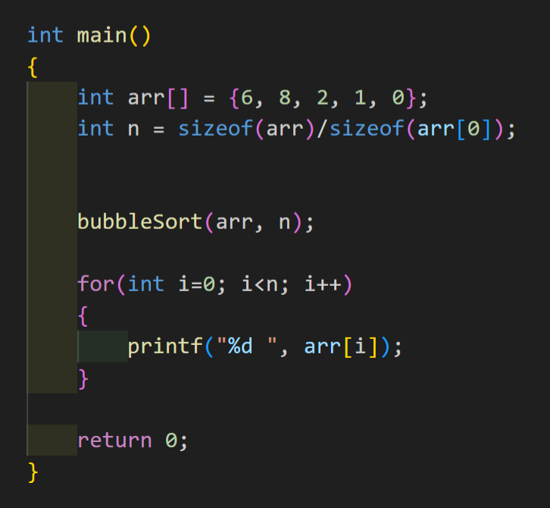
Main:

